Slide 1


Attendance Scan In
Valid within 15 mins before scheduled start time of the oral presentation
NTU PhD students (for Seminar Records purposes)
NTU Faculty/Staff (if requires attendance record)
DO NOT circulate the QR/Link code.
MUST attend the whole session.
Else disciplinary action will be taken.
https://forms.office.com/r/U4DV4KrmPs

Slide 2


Distributed Edge Intelligence Enabling Framework
for IoT-based Structural Health Monitoring
Speaker: Cui Shuaiwen | Supervisor: Asst. Prof. Fu Yuguang
Notes:
Good afternoon, everybody! Welcome to my QE oral presentation.
My name is Cui Shuaiwen, and I am supervised by Assistant Professor Fu Yuguang.
As shown here, my PhD researchis about a distributed edge intelligence enabling framework which is specially designed for low-cost and resource-constrained edge devices in IoT-based structural health monitoring.

Slide 3
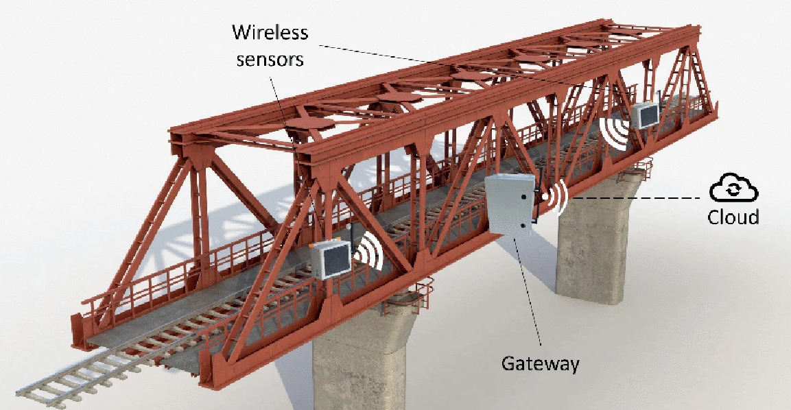




















Distributed Edge Intelligence Enabling Framework for IoT-based Structural Health Monitoring
Structural Health Monitoring (SHM) & Internet of Things (IoT)
SHM
Advantages
Low Cost
Ease of Installation & Maintenance
Edge Computing
Support for Customization
Real-time Performance
IoT-based SHM
Challenges
Front End
Back End
Limited Onboard Computing Resources
Insufficient Automation
Constrained Power
Supply
Lack of Tools / Libraries
sensor
gateway
server
Network Latency
Numerical Errors
SHUAIWEN CUI
NANYANG TECHNOLOGICAL UNIVERISITY | SINGAPORE
Introduction – Structural Health Monitoring (SHM) & Internet of Things (IoT)
SHUAIWEN CUI
Notes:
Let’s start the journey with Structural Health Monitoring and the Internet of Things.
SHM refers to the process of using a series of devices and analytical techniques to monitor, assess, and evaluate the performance of the target structures for decision-making.
Nowadays, SHM is deeply combined with IoT technologies. And a typical IoT-based SHM system features a frontend and a backend, including sensor, gateway, and remote server.
The prevalence of IoT-based SHM systems is based on it attractive advantages, including:
The low cost
edge computing capability
real-time performance
ease of installation and maintenance
support for customization
But at the same time, it is also suffering from many long-standing challenges, including
Limited Onboard Computing Resources
Limited Power Supply
Network Latency
Insufficient Automation
Lack of Tools / Libraries
Numerical Errors
This study targets on the first two challenges:
For the limited onboard computing resources, our solution is to develop lightweight edge computing and edge AI.
For the constrained power supply, there are two ways: one way is to increase power supply, like energy harvesting, but the problem is it may not be stable or enough. So we adopt the other way, which is to reduce power consumption by using power-saving hardware and software designs.

Slide 4











Distributed Edge Intelligence Enabling Framework for IoT-based Structural Health Monitoring
Distributed Edge Intelligence & Research Gap
Centralized Computing Distributed Computing
State of the Arts & Research Gaps
1 Microprocessor (MPU) vs Microcontroller (MCU)
MPU-Level Devices
MCU-Level Devices
Powerful
Expensive and Power-Hungry
Resource-Constrained
Cheap and Power-Saving
2 General-purpose vs Domain-specific Development
Advantages
General-Purpose
Frameworks
SHM-Specific
Frameworks
Workload & Expenses
Transmission Payload
3 Project-oriented vs Product-oriented Development
Power Consumption
Project-Oriented
Product-oriented
Response Latency
SHUAIWEN CUI
NANYANG TECHNOLOGICAL UNIVERISITY | SINGAPORE
Introduction – Distributed Edge Intelligence & Research Gap
SHUAIWEN CUI
Notes:
Then, let’s talk about computing paradigms.
Conventional IoT-based SHM systems adopt centralized computing, where almost all computational tasks are performed on the central server, featuring high latency and power consumption.
(2) In contrast, decentralized computing paradigm is to properly distribute computational tasks over the whole system so that the computational resources of the whole system can be utilized.
There are many advantages using distributed edge intelligence: the workload & expenses, transmission payload, power consumption, and response latency can be reduced at the same time at the cost of increased workload on the edge devices.
Regarding the state of the arts, I have identified several research gaps:
The first one is the gap between MPU devices to MCU devices. Many studies claimed to achieve edge intelligences but only turned out to be using MPU devices like Raspberry Pi or Nvdia Jetson series. MPU devices are powerful and easy for AI deployment, yet expensive and power-hungry, not suitable for long-term and large-scale SHM applications. In contrast, MCU devices is resource-constrained, yet cheap and power-saving, suitable for SHM.
The second one is the gap between the general-purpose development to domain-specific development. Currently, few frameworks focus on SHM, not to mention the support for edge intelligence enabled SHM.
The third one is the gap between the project-oriented development to product-oriented development. Many studies develop their nodes using a project-oriented manner rather than in a product-oriented manner, the framework in this study is going to be modularized and layered, easy for cross-platform reuse.

Slide 5




































Distributed Edge Intelligence Enabling Framework for IoT-based Structural Health Monitoring
Research Scope and Outline
Support
Drive
Prototype Development
Algorithm Development
Frontend
Backend
Smart Adaptive Triggering Mechanism
Feedback Control
MCU
Hardware
Missed Trigger
Computing
Storage
Digital Twin
Sensing
Software
- Threshold
- Duration
False Trigger
Edge AI
Network
Middleware
Brokering
Connection
Federated Learning for Event Classification
UI
App
Analyses
Control
Ambient Vibration
Classify
Impact
TinySHM
Earthquake
FS
Strong Wind
BMS
math
DSP
sensing
sys. id.
…
More …
commu.
AI
damage detection
Misc.
Computing
SHM
SHUAIWEN CUI
NANYANG TECHNOLOGICAL UNIVERISITY | SINGAPORE
Introduction – Research Scope and Outline
SHUAIWEN CUI
Notes:
Before you lose your patience, lets me outline my research contents.
My efforts for this study can be divided into two parts: Prototyping Development and Algorithm Development. These two parts support and drive each other.
So, a sensing platform development should have a frontend and a backend. And I do want to highlight that, the framework is embodied as a part of the middleware of the front end. For short, it is named as TinySHM. It features the capability of edge computing and intelligence, and specially designed for SHM.
As for algorithm development, there is no way to cover every topic in SHM. So, what I am doing here is to focus on several typical and important issues.
The first topic is to design a smart adaptive triggering mechanism to fine-tune triggering parameters for low false trigger and low missed trigger rates. And this topic is single-node level issue.
The second topic is a multi-node level issue, required coordination. It is about federated learning of event classification in SHM, and it has the potential to reduce transmission overhead and power consumption.
(3) In future, there will more …

Slide 6





Distributed Edge Intelligence Enabling Framework for IoT-based Structural Health Monitoring
Innovations and Contributions
Prototype Development
Algorithm Development
Low-power Low-Cost Edge Devices
Smart Adaptive Triggering Mechanism
Long-Term
Large-Scale
Autonomous
Adaptive Fast-convergence to Optimal Triggering Configurations
Methods: Feedback Control, Digital Twin, NN, Bayesian Optimization
Product-Oriented
Layered Architecture & Modularized Design
Domain-Specific, Specially for SHM
Federated Learning Workflow for Event Classification
for Structural Health Monitoring
Low Transmission Payload and Low Power Consumption
Edge Computing & Intelligence
Careful HW Selection & SW Integration
Lightweight Design
SHUAIWEN CUI
NANYANG TECHNOLOGICAL UNIVERISITY | SINGAPORE
Introduction – Innovations and Contributions
SHUAIWEN CUI
Notes:
Innovations and Contributions
For the prototype part:
(1) It is designed for low-power low-cost edge devices
(2) It is developed in a product-oriented manner
(3) It is domain specific, specially for SHM
(4) It supports edge computing and intelligence
As for the algorithm part:
For the adaptive triggering mechanism, we have achieved adaptive fast-convergence to optimal triggering configurations.
We have proposed a federated learning workflow for event classification featuring low transmission payload and low power consumption.

Slide 7




Distributed Edge Intelligence Enabling Framework for IoT-based Structural Health Monitoring
01
02
Prototype Development
Smart Adaptive Triggering
03
04
Federated Learning for Event Classification
Conclusions & Plans
SHUAIWEN CUI
NANYANG TECHNOLOGICAL UNIVERISITY | SINGAPORE
Introduction – Table of Contents
SHUAIWEN CUI
Notes:
The rest of this presentation will be organized in four chapters, with the first one about prototyping, the second and third one about algorithm development, and the last chapter is about conclusions and future plans.

Slide 8
Distributed Edge Intelligence Enabling Framework for IoT-based Structural Health Monitoring
01
02
Prototype Development
Smart Adaptive Triggering
03
04
Federated Learning for Event Classification
Conclusions & Plans
SHUAIWEN CUI
NANYANG TECHNOLOGICAL UNIVERISITY | SINGAPORE
01 Prototype Development
SHUAIWEN CUI
Notes:
Let’s move onto the first chapter, which is about the prototype development.

Slide 9















Distributed Edge Intelligence Enabling Framework for IoT-based Structural Health Monitoring
1-1 Sensing Platform Prototyping
Frontend
Backend
Sensing
Coordination
Computation
Storage
Storage
Computation
Communication
Analysis
LiftNode
LiftHub
Internet
Interfacing
SHUAIWEN CUI
NANYANG TECHNOLOGICAL UNIVERISITY | SINGAPORE
01 Prototype Development – Sensing Platform Prototyping
SHUAIWEN CUI
Notes:
As an IoT sensing platform, the prototype should have a frontend and a backend. Since this research is mainly about distributed edge intelligence, therefore the front end is mainly in charge of sensing and computation while the backend is only mainly in charge of coordination.
Given the importance of the edge computing, I will focus on the frontend today.

Slide 10








Distributed Edge Intelligence Enabling Framework for IoT-based Structural Health Monitoring
1-2 Hardware Development - Architecture
Framework
PERCEPTION
TinySHM
COMMUNICATION
Support
Enable
INTERACTION
LiftNode
MAIN CONTROL
POWER
Sensor
SHUAIWEN CUI
NANYANG TECHNOLOGICAL UNIVERISITY | SINGAPORE
01 Prototype Development – Hardware Development - Architecture
SHUAIWEN CUI
Notes:
Before delving deeper, I want to highlight two major ideas in this chapter, namely, the sensor prototye LiftNode, and the enabling framework, TinySHM. As shown here, LiftNode supports TinySHM. And TinySHM in turn enables the sensor LiftNode.
The sensor can be abstracted as the combination of 5 sub-systems, including the main control, perception, communication, interaction, and power system.

Slide 11






















Distributed Edge Intelligence Enabling Framework for IoT-based Structural Health Monitoring
1-2 Hardware Development - Architecture
Main Control
Perception
Communication
Interaction
Local Communication
Micro Controller Unit
Vibration
Command Input
Blue Tooth
SPI/I2C/UART/ADC/DAC/…
Strain
Status Monitoring
Zigbee
Timer/ RTC
Temperature &Humidity
Internet Communication
Power System
RAM/ROM Memory
Camera
WIFI
Battery / Power Outlet
Large Volume Storage
…
Cellular Network
Power Management System
SHUAIWEN CUI
NANYANG TECHNOLOGICAL UNIVERISITY | SINGAPORE
01 Prototype Development – Hardware Development - Architecture
SHUAIWEN CUI
Notes:
Each of these sub-systems is composed of many different components, and the development is still ongoing.

Slide 12






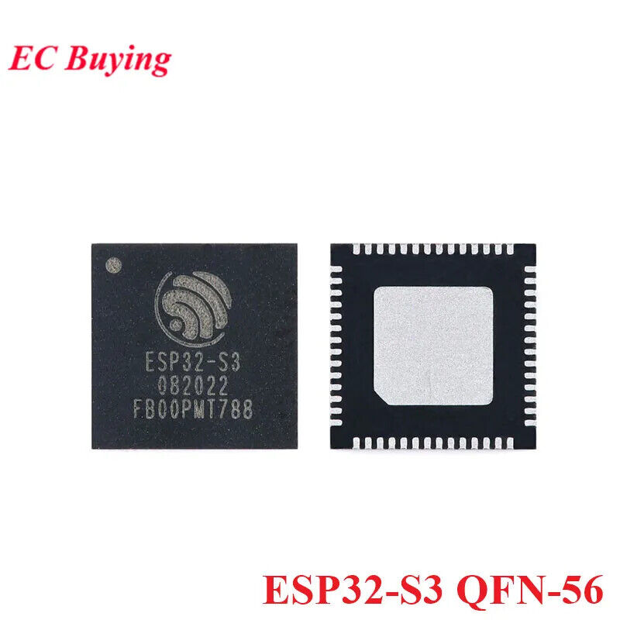


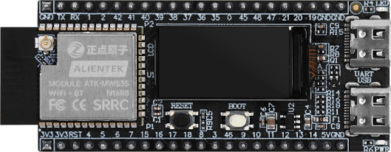






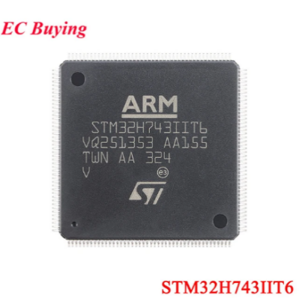

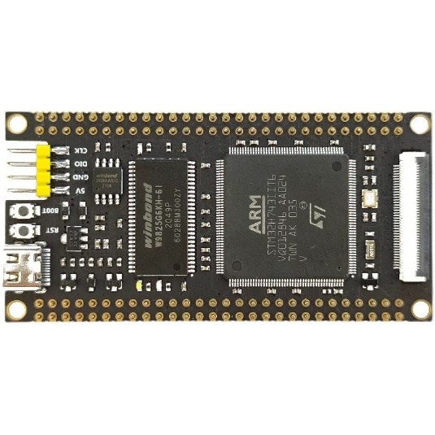

Distributed Edge Intelligence Enabling Framework for IoT-based Structural Health Monitoring
1-3 Hardware Development – MCU & Main Control Board
MCU Selection
Main Control Board Selection
Espressif - ESP32
Alientek - DNESP32S3M Devkit
Toolchain
AI Support
MCU
RAM
LED
Button
ESP32-S3
Dual-Core
240MHz
SRAM: 512 KB
PSRAM: 8 MB
Power: 1
User: 1
RESET 1
BOOT/USER 1
ROM
TF Card
IO
Screen
ESP32-S3
ESP-IDF
ESP-DL
ROM: 384 KB
FLASH: 16 MB
Up to 32 GB
PIN: 36
0.96’’ LCD
~ 20 SGD
ST Electronics - STM32
Fanke - STM32H743IIT6 Devkit
Toolchain
AI Support
MCU
RAM
LED
Button
STM32H743
480MHz
SRAM: 1 MB
SDRAM: 32 MB
Power: 1
User: 1
RESET 1
BOOT/USER 1
ROM
TF Card
IO
STM32H743
STM32CUBE
X-CUBE-AI
ROM: 2 MB FLASH: 8 MB
Up to 32 GB
PIN: 112
~ 24 SGD
SHUAIWEN CUI
NANYANG TECHNOLOGICAL UNIVERISITY | SINGAPORE
01 Prototype Development – Hardware Development – MCU & Main Control Board
SHUAIWEN CUI
Notes:
To facilitate the prototyping, I investigated several major MCU brands ESP32 and STM32. Both of them are famous for good toolchain and support onboard AI.
And then I selected to main control boards built upon these two microprocessors. And if you check the computational related resources, you will find they are very typical MCU-level devices. Apart from that, they are very cheap, only around 20 SGDs, that can give you some idea why MCU devices are suitable for large scale uses.

Slide 13

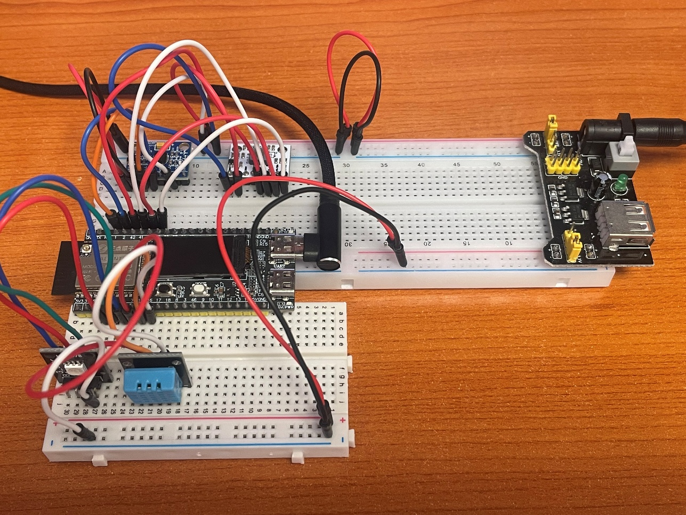
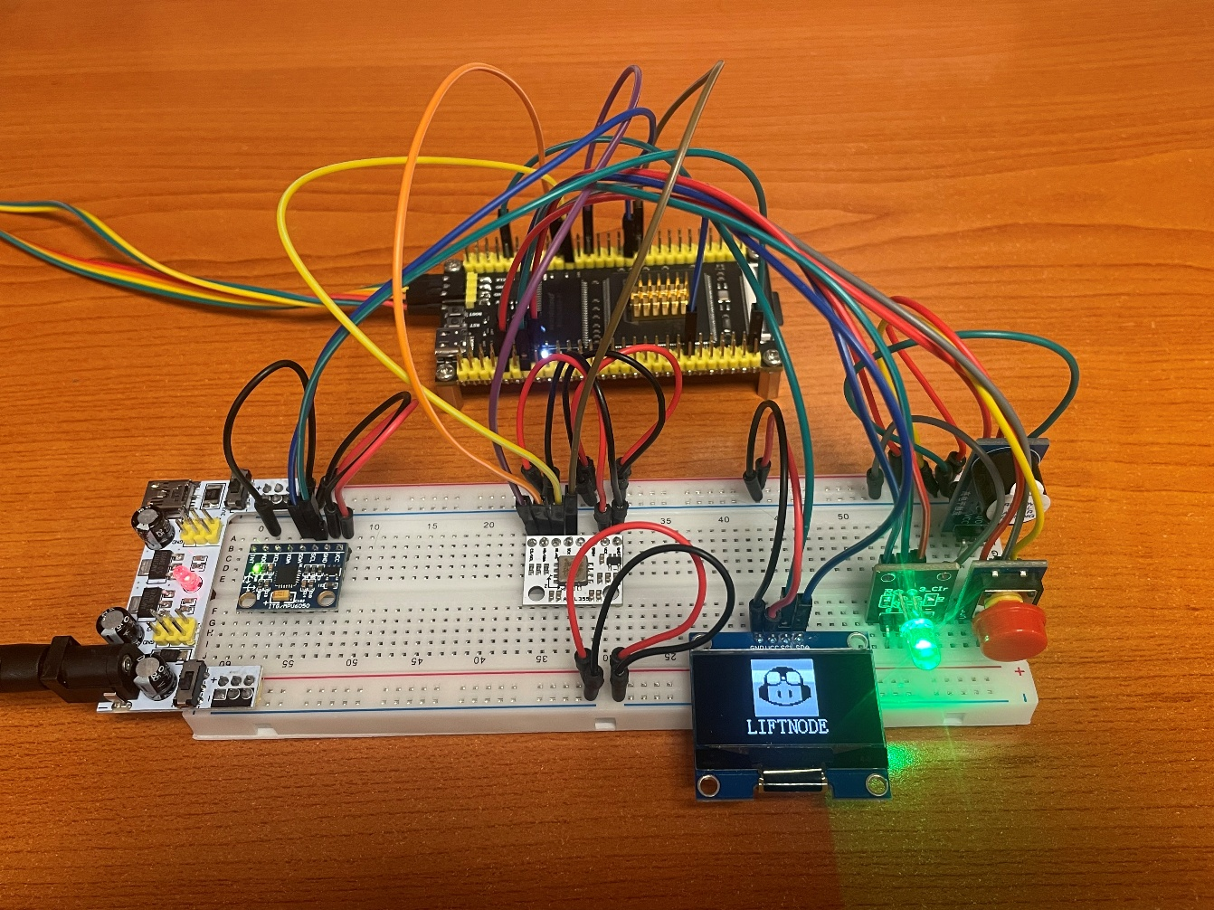
Distributed Edge Intelligence Enabling Framework for IoT-based Structural Health Monitoring
1-4 Hardware Development – LiftNode Prototypes
ESP32
STM32
FANKE STM32H743
ATK DNESP32S3M
SHUAIWEN CUI
NANYANG TECHNOLOGICAL UNIVERISITY | SINGAPORE
01 Prototype Development – Hardware Development – LiftNode Prototypes
SHUAIWEN CUI
Notes:
Shown here are the physical prototypes using ESP32 and STM32.

Slide 14
Distributed Edge Intelligence Enabling Framework for IoT-based Structural Health Monitoring
1-5 Software Development - Architecture
Application Specific Code
Application
Edge Intelligence Library for SHM Applications - TinySHM
Middleware
Damage Detection
Notification
…
RTOS – Task Scheduling
FS – File Operation
TCP/IP & MQTT – Internet Communication
DSP/AI – Onboard Computing
TinySHM – Commonly Used Functions in App Layer
Measurement
System Identification
Math
DSP
AI
Config
Sense
File
Network
File System
TCP/IP & MQTT
Digital Signal Processing
Edge AI Framework
Real-time Operating System (RTOS)
Startup Code
Hardware Abstraction Drivers (Register-Level)
Board Support Packages
(Board-Level)
Drivers
Platform-specific
Main
Control
Peripheral Components
Sensing / Communication / Interaction / Power Supply
Hardware
SHUAIWEN CUI
NANYANG TECHNOLOGICAL UNIVERISITY | SINGAPORE
01 Prototype Development – Software Development – Architecture
SHUAIWEN CUI
Notes:
Now it’s to move onto the software architecture. It adopts a typical 4-layer architecture.
The bottom layer is the hardware layer, standing for the physical components.
And second to last layer is the driver layer, which is platform-specific.
On top of that is the middleware layer, including many high-level functions. Most importantly, the framework TinySHM is in this layer.
The top layer is the application layer.

Slide 15
Distributed Edge Intelligence Enabling Framework for IoT-based Structural Health Monitoring
1-6 TinySHM
Application Specific Code
TinySHM Math
TinySHM DSP
Matrix Multiplication
Convolution
Eigen Value Computation
Singular Value Decomposition
…
Up-sampling & Down-sampling
Discrete Wavelet Transform
Independent Component Analyses
…
Edge Intelligence Library for SHM Applications - TinySHM
Damage Detection
Notification
…
Measurement
System Identification
Math
DSP
AI
Config
Sense
File
Network
File System
TCP/IP & MQTT
Digital Signal Processing
Edge AI Framework
Real-time Operating System (RTOS)
TinySHM AI
Startup Code
Hardware Abstraction Drivers (Register-Level)
Board Support Packages
(Board-Level)
Gaussian Process Regression
Stochastic Process Control
Convolutional Neural Network (CNN)
Dense Neural Network Predictor (DNN)
Main
Control
Peripheral Components
Sensing / Communication / Interaction / Power Supply
SHUAIWEN CUI
NANYANG TECHNOLOGICAL UNIVERISITY | SINGAPORE
01 Prototype Development – TinySHM
SHUAIWEN CUI
Notes:
The TinySHM framework features many modules for different tasks. And here, I would like to focus on the modules related to computation and AI for SHM.
Unlike on computer, few people will try edge computing on MCU devices not to mention SHM. So, I need to develop the tools by myself.
Listed here are the functions summarized from some past projects using edge computing. For example:
For math operations, there are matrix multiplication, convolution, eigen value computation, and etc.
For digital signal processing, there are resampling, wavelet transform, independent component analyses, and etc.
For AI, there are Gaussian Process Regression, CNN, DNN

Slide 16
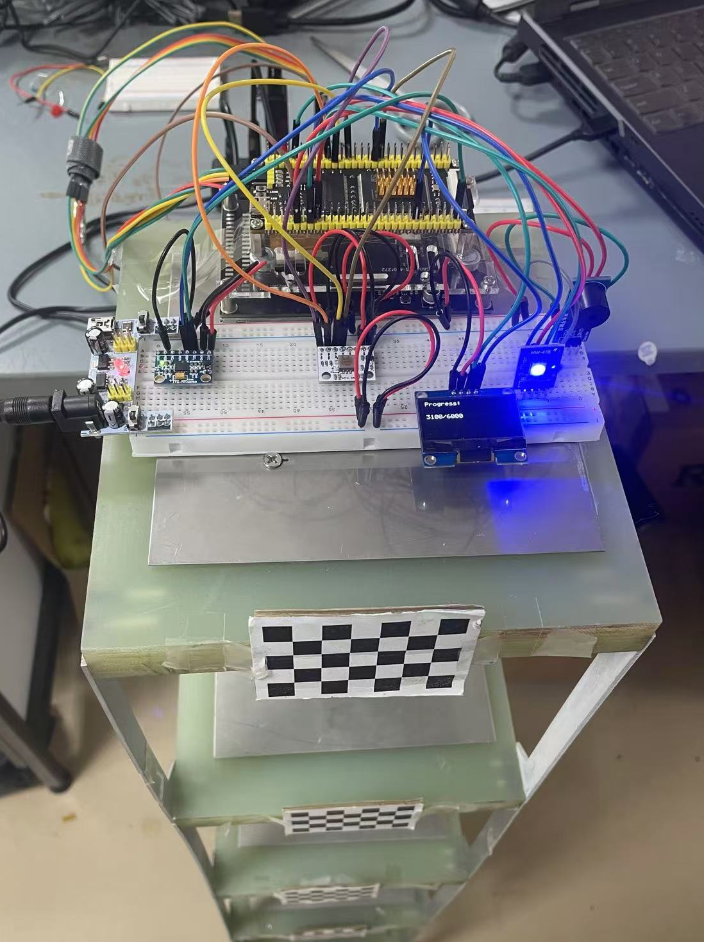
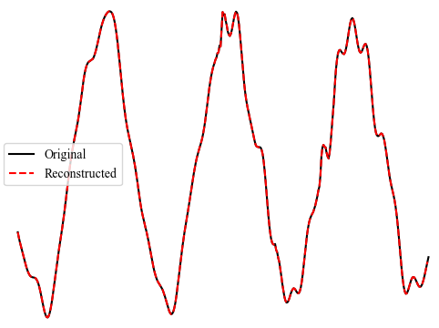
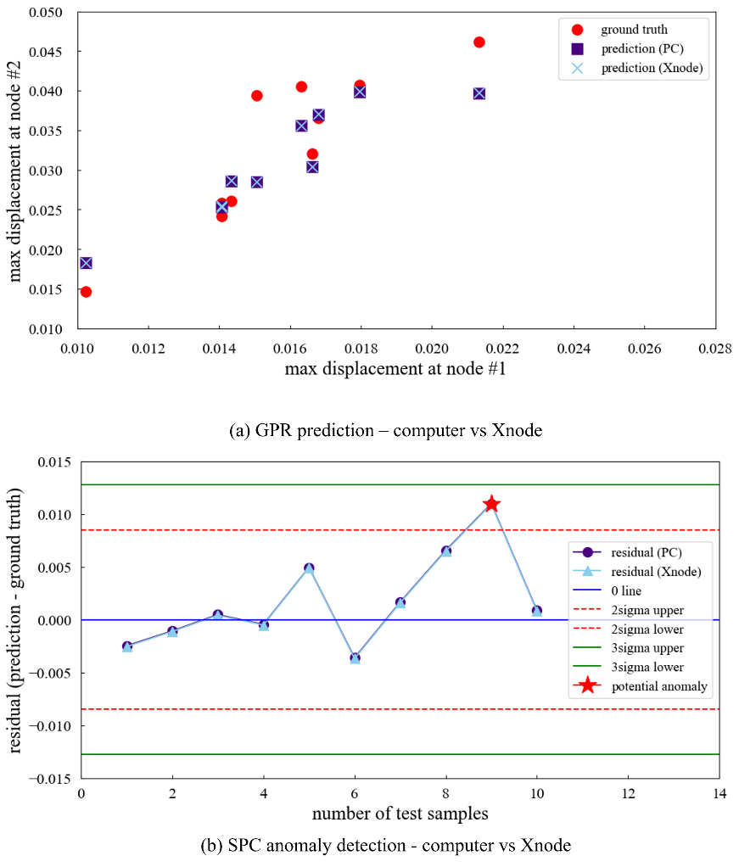
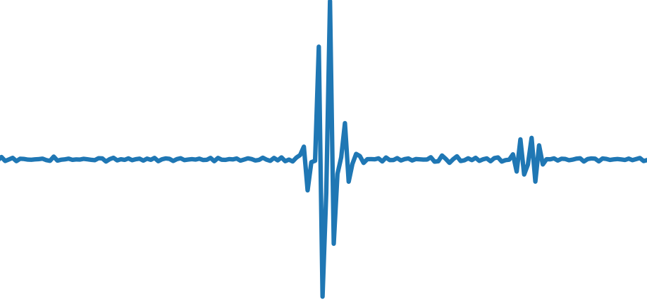
Distributed Edge Intelligence Enabling Framework for IoT-based Structural Health Monitoring
1-7 Validation in Applications
Data Collection
MATH/DSP
AI
Onboard Wavelet Transform (WT)
Sudden Damage Detection
Data-driven Anomaly Detection
SHUAIWEN CUI
NANYANG TECHNOLOGICAL UNIVERISITY | SINGAPORE
01 Prototype Development – Unit Tests
SHUAIWEN CUI
Notes:
You may wonder whether the porotype can be used for real applications, and here are some examples.
The left part is about data sensing in chapter 2.
The middle part is about damage detection using wavelet transform.
The right part is about anomaly detection using Gaussian Process Regression, showing a good match with PC results.

Slide 17
Distributed Edge Intelligence Enabling Framework for IoT-based Structural Health Monitoring
01
02
Prototype Development
Smart Adaptive Triggering
03
04
Federated Learning for Event Classification
Conclusions & Plans
SHUAIWEN CUI
NANYANG TECHNOLOGICAL UNIVERISITY | SINGAPORE
02 Smart Adaptive Triggering
SHUAIWEN CUI
Notes:
Chapter 2 is about a smart adaptive triggering mechanism.

Slide 18

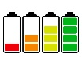



Distributed Edge Intelligence Enabling Framework for IoT-based Structural Health Monitoring
2-1 Sensing Schemes and Event-trigger Sensing
Always-on
Duty-cycle
Event-triggered
active
inactive
events of interest
partially miss out
inactive miss out
low power miss out
SHUAIWEN CUI
NANYANG TECHNOLOGICAL UNIVERISITY | SINGAPORE
02 Smart Adaptive Triggering – Sensing Schemes and Event-Trigger Sensing
SHUAIWEN CUI
Notes:
For SHM, many devices run on batteries, so power efficiency is super important.
If sensors stay on all the time, the battery will drain quickly.
To save power, we can use duty-cycling, where sensors wake up periodically. But the downside is, they might miss important events while sleeping.
That’s why event-triggered sensing was introduced, where sensors only wake up when required, saving power while capturing critical data.

Slide 19
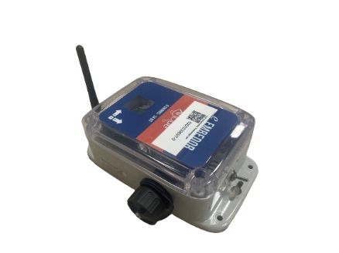
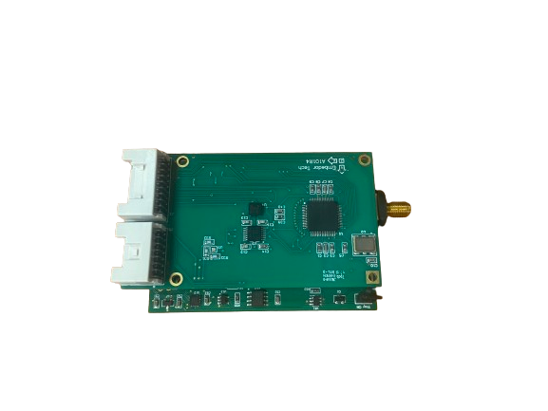
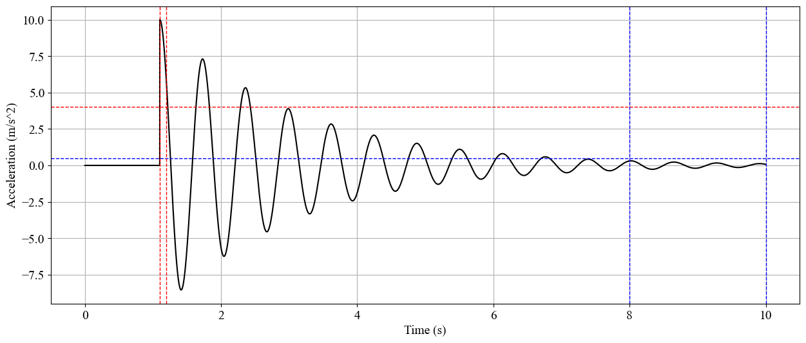
Distributed Edge Intelligence Enabling Framework for IoT-based Structural Health Monitoring
2-2 Trigger Sensing Mechanism
Xnode - Trigger Sensing Mechanism
Trigger Sensing Mechanism
LIS344
Activation
Duration
ADXL362
Low-power Sensor + High-resolution Sensor
Activation
Threshold
Sentry Mode: Low Power, Low Resolution
Deactivation
Threshold
ADXL362
resolution: 12-bit
power consumption:
1.8uA (sensing, 100Hz) ; 270nA (sleep)
Deactivation
Duration
Triggering Parameters:
Threshold: absolute value, continuous
Duration: number of sampling points, discrete integers
Working Mode: High Power, High Resolution
LIS344
resolution: 24-bit
power consumption:
~ 5mW (sensing); 3uA(sleeping)
A Two-class Classifier
make mistakes, to be improved
SHUAIWEN CUI
NANYANG TECHNOLOGICAL UNIVERISITY | SINGAPORE
02 Smart Adaptive Triggering – Trigger Sensing Mechanism
SHUAIWEN CUI
Notes:
How can we achieve event-triggered sensing? Let me use the XNode as an example.
It involves two sensors: a low-power, low-resolution sensor and a high-power, high-resolution sensor. These sensors operate in two modes, sentry mode and working mode.
In sentry mode, the low-power sensor monitors for events of interest. Once detected, the system switches to working mode, waking up the high-resolution sensor to collect detailed data.
On the right-hand side, you can see how the triggering mechanism works: when the input signal exceeds the threshold for a certain duration, the high-resolution sensor is activated. Essentially, this is a two-class classifier.
As a classifier, it make mistakes, and is remained to be improved.

Slide 20
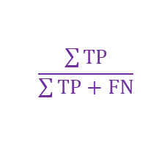
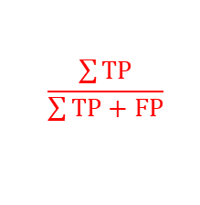
Distributed Edge Intelligence Enabling Framework for IoT-based Structural Health Monitoring
2-3 Triggering Mechanism Performance
Confusion Matrix
Objective
Ground Truth
Optimal Configuration for
positive
negative
Minimize Missed Trigger
False Trigger at Low Level
True Positive (TP)
False Positive (FP)
[TYPE I]
False Trigger
positive
$$\frac{\sum{TP}}{\sum{TP+FP}}$$
precision
Prediction
False Negative (FN)
[TYPE II]
Missed Trigger
True Negative (TN)
Multi Objective Problem
negative
Trade-off Required
$$\frac{\sum{TP}}{\sum{TP+FN}}$$
recall
SHUAIWEN CUI
NANYANG TECHNOLOGICAL UNIVERISITY | SINGAPORE
02 Smart Adaptive Triggering – Triggering Mechanism Performance
SHUAIWEN CUI
Notes:
To improve this mechanism, we first need to characterize its performance. We can use a confusion matrix.
There are two types of errors we care about: false triggers and missed triggers. To assess these errors, we use two associated metrics: precision and recall.
The goal is to minimize missed triggers while also keeping false triggers low. But there’s a trade-off between these two objectives.

Slide 21






Distributed Edge Intelligence Enabling Framework for IoT-based Structural Health Monitoring
2-4 Challenges & Potential Enablers
Lack of Adaptivity
Unknown / Imbalanced Data
Partial Observability
Summary
Preconfigured Parameters
Fixed Values
Unknown & Imbalanced
Data Distribution
No information of uncaptured events
Closed Loop Control
Backbone for Adaptivity
F-beta
Feedback Control & Bayesian Optimization
Artificial Distribution & Digital Twin
Edge AI for Prediction
Digital Twin
Data Augmentation
Feedback Acceleration
Pre-Optimization
Multiple Objective
No Ground Truth
Costly Feedback
Neural Networks
Multiple Objectives
Trade-off Required
No Ground Truth for Captured Events
Long-term / Costly to Capture Enough Records
Ground Truth Estimation
Unobservable Value Estimation
Comprehensive Metric
Edge AI for Classification
Digital Twin
Bayesian Optimization
Parameter Optimization
Fast Convergence
SHUAIWEN CUI
NANYANG TECHNOLOGICAL UNIVERISITY | SINGAPORE
02 Smart Adaptive Triggering – Challenges & Potential Enablers
SHUAIWEN CUI
Notes:
We have several critical challenges, but accordingly, we can find some solutions to deal with them.
First, lack of adaptivity: Triggering parameters are fixed and can’t adapt to the environment. To solve this, we can use feedback control or Bayesian approaches to optimize parameters based on observations.
Second, as mentioned, this is a multi-objective problem: A comprehensive metric can help balance these objectives.
Third, the input data to the triggering mechanism is unknown and may be imbalanced. This means our evaluation can be quite difficult. One solution is to use artificial dataset.
Fourth, We have no ground truth for the captured events on the edge. We can use AI for estimation.
Fifth, Observability Issues: Since only triggered events are captured, we don’t know how many are missed. We can also use AI for estimation.
Finally, Costly Feedback: Capturing enough data for evaluation can be time- and power-consuming. We can use digital twin to accelerate.
In summary, we can jointly use closed-loop control, digital twins, neural networks, and Bayesian optimization, to form a comprehensive solution.

Slide 22




Distributed Edge Intelligence Enabling Framework for IoT-based Structural Health Monitoring
2-5 Smart Adaptive Triggering Mechanism (SATM)
Closed Loop Control
Multi-Stage Deployment
1 Environment
2 System
ref
response
Stage I
Initialization
4 Controller
Stage II
Digital Space Optimization
parameters
3 Estimator
TP/FP/FN
Stage III
Real World Optimization
F-beta
1 Environment
structure response under different events
Stage I
Stage II
Stage III
2 System
triggering mechanism (threshold & duration)
data synthesizing using digital twin
neural network training
preliminary optimization in digital twin
onboard fine-tuning using edge intelligence
3 Estimator
Metric harmonizing recall & precision
4 Controller
Bayesian Optimization
SHUAIWEN CUI
NANYANG TECHNOLOGICAL UNIVERISITY | SINGAPORE
02 Smart Adaptive Triggering – Smart Adaptive Triggering Mechanism (SATM)
SHUAIWEN CUI
Notes:
Given the importance of adaptivity, we can use closed loop control as the backbone.
As shown, the closed-loop control model has four major components: Environment, System, Estimator, and Controller. I will introduce them one by one later.
As for deployment, to accelerate onboard optimization, we can use digital twin, and we can divide the process into digital space optimization and real-world optimization. Digital space is for preliminary optimization and the real world for fine-tuning. Apart from these two stages, we need an initialization stage for preparation.

Slide 23



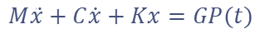
Distributed Edge Intelligence Enabling Framework for IoT-based Structural Health Monitoring
2-6 The Closed Loop Control (Feedback Control)
[DIGITAL TWIN]
2 The System
1 The Environment
Structure Response
The Triggering Mechanism
Excitation
Ambient Vibration
Earthquake
Impact
Strong Wind
Structure
Equation of Motion
$$k_{5}$$
$$c_{5}$$
$$k_{4}$$
$$c_{4}$$
$$M\ddot{x}+C\dot{x}+Kx=GP(t)$$
Physical
Structure
Digital
Twin
$$k_{3}$$
$$c_{3}$$
Newmark Beta
$$k_{2}$$
$$c_{2}$$
Structure Response
$$k_{1}$$
$$c_{1}$$
Triggering Parameters:
Threshold: absolute value, continuous
Duration: number of sampling points, discrete integers
Response
Real
Virtual
SHUAIWEN CUI
NANYANG TECHNOLOGICAL UNIVERISITY | SINGAPORE
02 Smart Adaptive Triggering – The Closed Loop Control (Feedback Control)
SHUAIWEN CUI
Notes:
The environment component refers to the structure responses. This is also where digital twin comes into play.
As you can see, we started with excitations of different event types, including ambient vibration, earthquake, impact and strong wind. Then the structures, both the physical and the digital twin. Note that the digital twin is modeled by the equation of motion and Newmark beta method. Finally, we have the response from the real and virtual spaces.
The system component, which, in our case, refers to the triggering mechanism itself, which is based on threshold and duration.

Slide 24
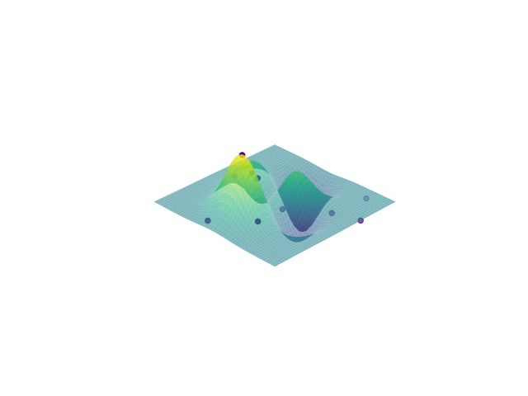
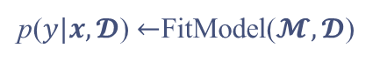

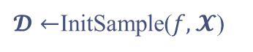

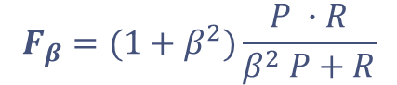
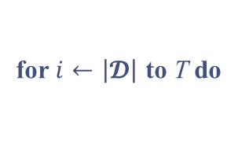
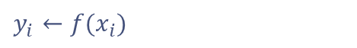

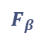
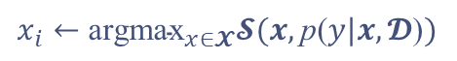
Distributed Edge Intelligence Enabling Framework for IoT-based Structural Health Monitoring
2-6 The Closed Loop Control (Feedback Control)
[NEURAL NETWORKS]
[BAYESIAN OPTIMIZATION]
3 The Estimator
4 The Controller
The Performance Metric
The Engine for Optimization
$$F_{β}=(1+β^{2})\frac{P ∙R}{β^{2} P+R}$$
balances recall and precision
$$F_{β}$$
Black Box Problem
$$β$$
Expensive Evaluation
Esimator in Digital Twin
threshold
duration
Bayesian Optimization
F-beta
Precision
TP
Bayesian Optimization Algorithm Framework
Recall
FP
Require：$f, 𝓧, 𝓢, 𝓜$
function / variable domain / acquisition function / surrogate model
FN
$𝓓←$InitSample($f,𝓧$)
initialize the observation set
for $i←\left|\left.𝓓\right|\right.$ to T do
Esimator in Real World
p($y|x, 𝓓$) $←$FitModel($𝓜,𝓓$)
surrogate model regression
F-beta
Precision
TP, FP
CNN Classsifier
$x_{i}←$ ${\text{argmax}}_{x∈𝓧}𝓢(x,\text{p}\text{(}y|x, 𝓓\text{)})$
determine next point to investigate
$$y_{i}←f(x_{i})$$
get corresponding value
Recall
DNN Predictor
$𝓓←𝓓 ∪(x_{i},y_{i})$
update the observation set
end for
SHUAIWEN CUI
NANYANG TECHNOLOGICAL UNIVERISITY | SINGAPORE
02 Smart Adaptive Triggering – The Closed Loop Control (Feedback Control)
SHUAIWEN CUI
Notes:
[ESTIMATOR]
The estimator is used to provide a performance metric to evaluate the system component. This is also where NN comes into play.
For this, we use the F-beta score, a machine learning tool that balances precision and recall by tuning the beta value.
The estimator operates differently in the digital twin stage and the real-world deployment stage:
In the digital twin stage, everything is known, so the F-beta score is calculated using upstream metrics like TP, FP, and FN.
In the real-world stage, a CNN model is used to provide ground truth label, and a DNN model is used to estimate Recall due to observability issues.
[CONTROLLER]
The controller is the engine for optimization. We use Bayesian Optimization for the controller.
So why we use it?
Blackbox problem
Expensive Evaluation
The key idea of Bayesian Optimization is that it uses a surrogate model to approach the objective function.
And it is an iterative process, for each iteration, it determines the next point to observe by balancing exploration and exploitation.
Another desirable feature is that the whole process can be characterized and recorded by the observation dataset. This is also the key why we can divide the process into multi stages.

Slide 25




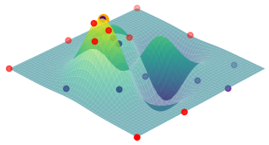


Distributed Edge Intelligence Enabling Framework for IoT-based Structural Health Monitoring
2-7 Multi-Stage Deployment Strategy
Stage I - Initialization
Stage II – Digital Space Optimization
Data Synthesization
ref
Digital Space Response
response
Triggering Mechanism
Events
Bayesian Optimization
(Preliminary)
parameters
Structures
real
virtual
$$F_{β}$$
Precision
TP/FP/FN
F-beta
Recall
Responses
real
virtual
Stage III – Real World Optimization
NN Training
CNN classifier
DNN predictor
ref
Real World & Digital Space Response
response
Triggering Mechanism
Features
Noise
Threshold
Duration
Bayesian Optimization
(Fine-tuning)
parameters
$$F_{β}$$
Precision
CNN
Labels
Recall
F-beta
Recall
DNN
SHUAIWEN CUI
NANYANG TECHNOLOGICAL UNIVERISITY | SINGAPORE
02 Smart Adaptive Triggering – Multi-Stage Deployment Strategy
SHUAIWEN CUI
Notes:
The deployment is divided into three stages:
STAGE I - INITIALIZATION There are two major tasks:
Data Synthesization: To prepare the dataset used in NN training and subsequent stages.
Neural Network Training: Train a lightweight CNN-based classifier and a DNN-based predictor for stage III.
STAGE II – DIGITAL SPACE OTPIMIZATION This stage is mainly for reducing the workload of real-world optimization. Basically, the optimization is conducted in virtual environment. And the results can be directly applied to stage III for fine-turning.
But this assumes that the data distribution in the virtual world is close to the one in real world. And the key is to ensure the simulated data aligns with real-world characteristics, especially for ambient vibration, like average amplitude and standard deviation.
STAGE III – REAL WORLD OPTIMIZATION
This stage is for trigger parameter fine-tuning.
There are some difference from stage II that you might have noticed.
- The dataset is mixed, from both the real world and the digital space.
- The precision and recall are provided directly or indirectly by edge AI.

Slide 26
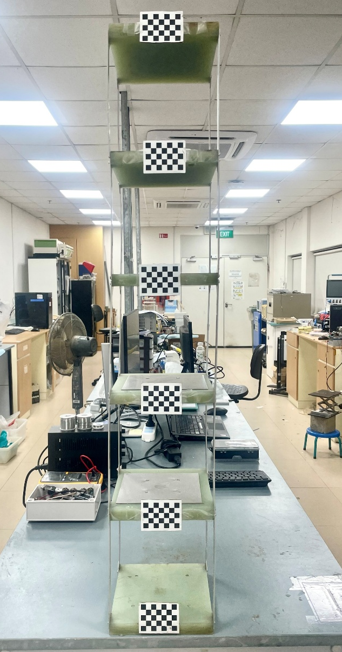

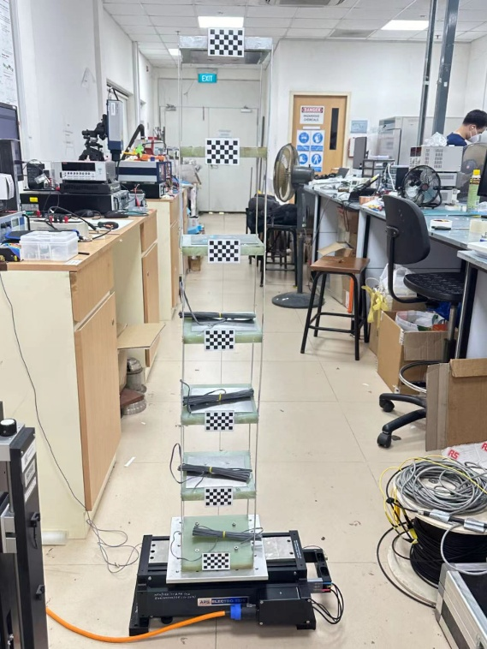
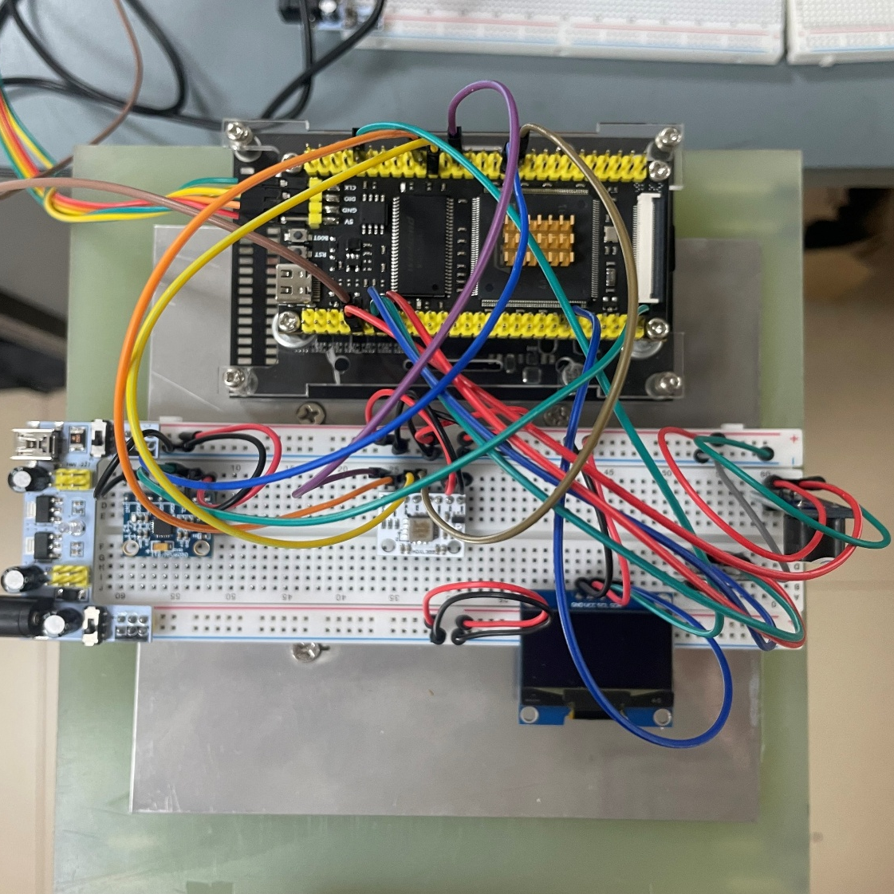
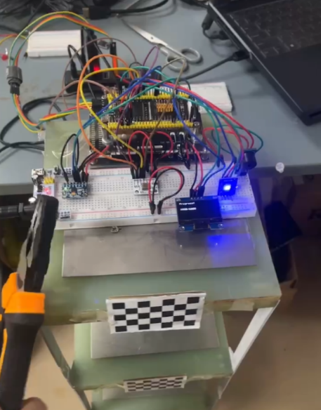
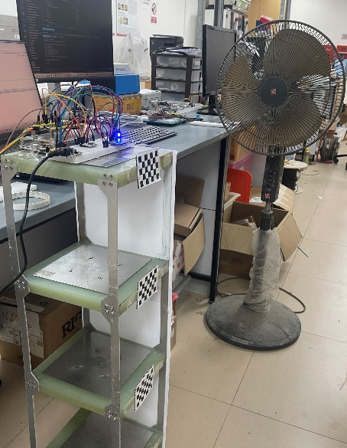
Distributed Edge Intelligence Enabling Framework for IoT-based Structural Health Monitoring
2-8 Validation – Laboratory Test Setup
Structure Model
LiftNode (STM32-based)
Ambient Vibration
Earthquake
Impact
Strong Wind
SHUAIWEN CUI
NANYANG TECHNOLOGICAL UNIVERISITY | SINGAPORE
02 Smart Adaptive Triggering – Validation – Laboratory Test Setup
SHUAIWEN CUI
Notes:
To validate the proposed smart adaptive triggering mechanism, laboratory tests were conducted, as shown here.
Here are the model structure and the sensor prototype for data collection. For different events, there are different ways for simulation.

Slide 27

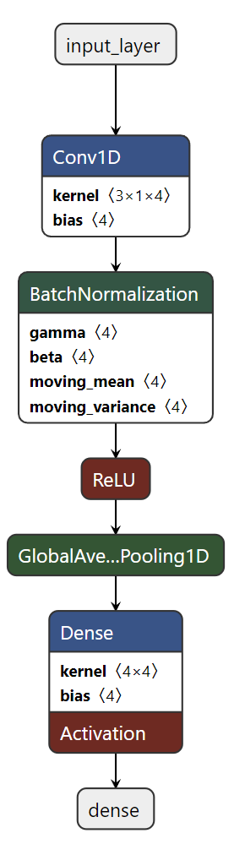
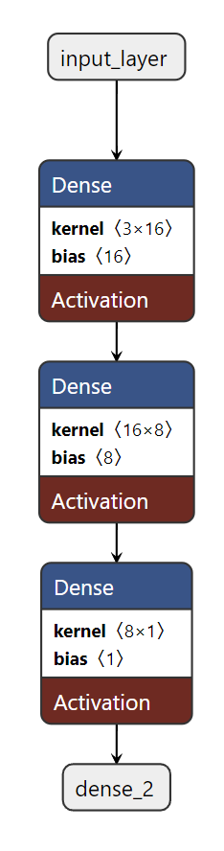
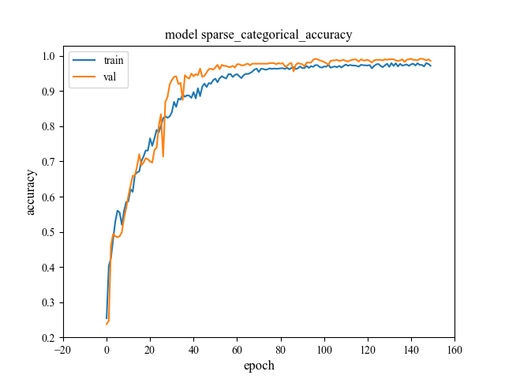




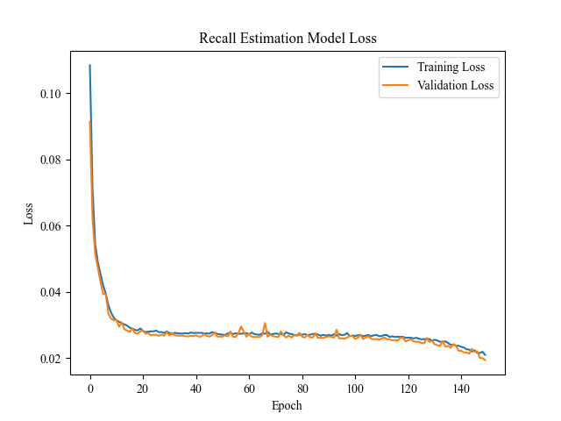
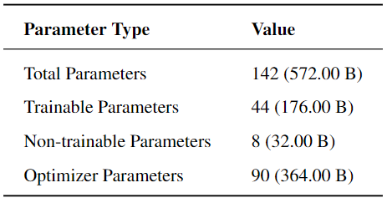
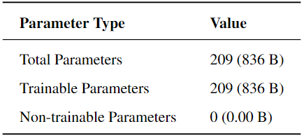
Distributed Edge Intelligence Enabling Framework for IoT-based Structural Health Monitoring
2-8 Validation – Stage I: Initialization
Dataset Synthesizing
Ambient Vibration
1000 records 60s@100Hz
Impact
1000 records 60s@100Hz
Earthquake
1000 records 60s@100Hz
Strong Wind
1000 records 60s@100Hz
Test Acc 99.55%
Lightweight Neural Network Training
CNN
DNN
SHUAIWEN CUI
NANYANG TECHNOLOGICAL UNIVERISITY | SINGAPORE
02 Smart Adaptive Triggering – Validation – Stage I: Initialization
SHUAIWEN CUI
Notes:
[DATA SET]
1000 records (each 60 seconds at 100 Hz) were synthesized for each event type.
[NN]
A classification network to provide ground truth for event detection.
A recall estimation network to predict recall values.
On the right are the architectures and training curves of these neural networks. As shown, both are lightweight and powerful.

Slide 28
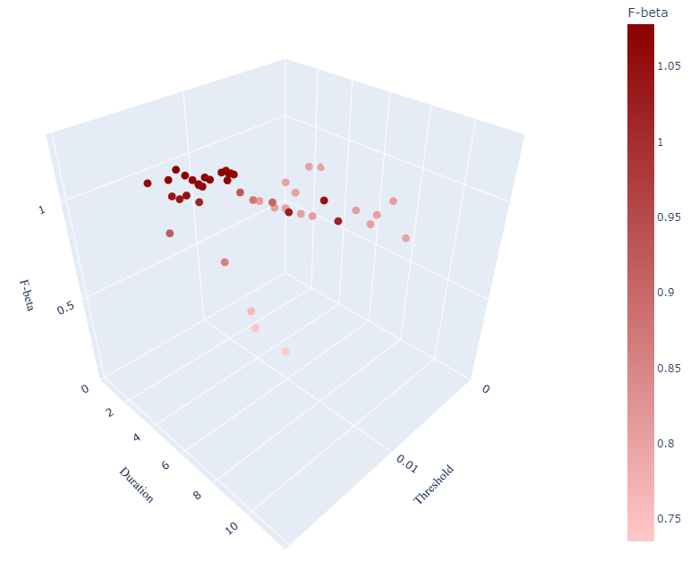

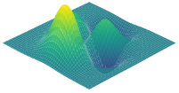


Distributed Edge Intelligence Enabling Framework for IoT-based Structural Health Monitoring
2-8 Validation – Stage II: Digital Space Optimization
Optimization in Digital Twin
$$F_{β}$$
$$F_{β}$$
threshold
duration
threshold
duration
Objectives:
Rough Model between Triggering Parameters and Performance
Save Resources for Real-world Optimization
Dataset:
Ambient Vibration: 600 records (same level of real world)
Impact, Earthquake, Strong Wind 200 records each from Stage I Dataset
Procedures:
Initialization: 15 random observation points
Iteration: 30 observation points
SHUAIWEN CUI
NANYANG TECHNOLOGICAL UNIVERISITY | SINGAPORE
02 Smart Adaptive Triggering – Validation – Stage II: Digital Space Optimization
SHUAIWEN CUI
Notes:
For stage II, as shown on the right-hand side, in the digital space, 15 points were randomly generated for initialization, and 30 points were generated for iterative optimization.
It can be seen that the points gradually aggregate at a small area with high F-beta score.
Stage II focuses on roughly modeling the data distribution and performing preliminary optimization of the triggering parameters.
In this stage, 600 records of ambient vibration and 200 records each for impact, earthquake, and strong wind were used for optimization.
As shown on the right, the process starts with 15 random observation points for initialization, followed by a 30-point iterative optimization. To speed up the process, a bonus factor was applied in cases where both recall and precision exceeded 0.9. Otherwise, the theoretical maximum score was capped below 1.

Slide 29
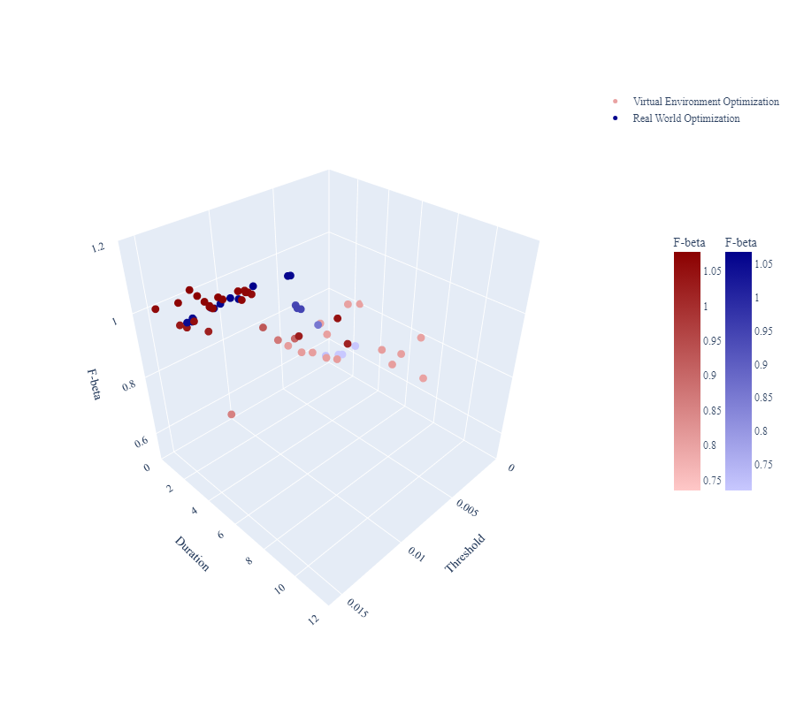


Distributed Edge Intelligence Enabling Framework for IoT-based Structural Health Monitoring
2-8 Validation – Stage III: Real World Optimization
Optimization in Real World
$$F_{β}$$
$$F_{β}$$
threshold
duration
threshold
duration
Objectives:
Fine-tuning Triggering Parameters Using Real-world Feedback
Dataset:
Ambient Vibration: 150 records from real world
Impact, Earthquake, Strong Wind 50 records each from Stage I Dataset & Gradually Replaced by Collected Data
Procedures:
Iteration: 20 observation points
SHUAIWEN CUI
NANYANG TECHNOLOGICAL UNIVERISITY | SINGAPORE
02 Smart Adaptive Triggering – Validation – Stage III: Real World Optimization
SHUAIWEN CUI
Notes:
For stage III, as shown on the right-hand side, 20 more points were observed for fine-tuning optimization. There are two key points can be observed.
First, the red dots and the blue dots share similar peak values at similar area. This is to say the data distribution is quite close.
Second, the average score for blue dots is significantly higher than the red ones. This is to say that the pre-optimization in stage II is effective.
Stage III focuses on onboard fine-tuning, building on the results from Stage II. The prior knowledge is transferred through the observation dataset.
The optimization dataset includes 150 locally collected records and 50 records each for impact, earthquake, and strong wind. The data distribution is identical or very similar to Stage II. Over time, the dataset can be gradually replaced by newly captured data for long-term optimization.
For optimization, 20 rounds of iteration were performed, achieving results equivalent to Stage II.
This demonstrates that Stage II effectively reduces the computational and energy load in Stage III.
Additionally, the maximum values in both stages are located in the same region, confirming a strong match in data distribution and validating the underlying assumption.

Slide 30
Distributed Edge Intelligence Enabling Framework for IoT-based Structural Health Monitoring
01
02
Prototype Development
Smart Adaptive Triggering
03
04
Federated Learning for Event Classification
Conclusions & Plans
SHUAIWEN CUI
NANYANG TECHNOLOGICAL UNIVERISITY | SINGAPORE
03 Federated Learning for Event Classification
SHUAIWEN CUI

Slide 31
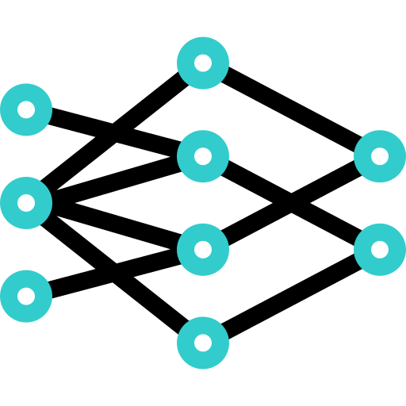
Distributed Edge Intelligence Enabling Framework for IoT-based Structural Health Monitoring
3-1 Federated Learning (FL)
Background and Gaps
FL Mechanism
Google 2016
Decentralized Framework
Privacy & Efficiency for IoT & Mobile Devices
Few Studied FL in IoT-based SHM, not to mention MCU devices
①
Model Distribution
Server
②
Model Training
④
③
Model Uploading
④
Model Aggregation
③
①
③
①
①
③
Features
②
②
②
Localized Data Usage, No Raw Data Transmission
Energy-Efficient
Privacy-Preserving
…
Client 1
Client 2
Client n
Challenges: (1) Onboard Training; (2) Multi-Node Coordination
SHUAIWEN CUI
NANYANG TECHNOLOGICAL UNIVERISITY | SINGAPORE
03 Federated Learning for Event Classification – Federated Learning
SHUAIWEN CUI
Notes:
Federated Learning, is introduced by Google in 2016, is a typical decentralized framework aiming at privacy and efficiency issues for IoT and mobile devices.
In the domain of Structural Health Monitoring (SHM), very few studies have tried Federated Learning, not to mention on resource constrained devices.
Federated Learning features::
local data usage and no raw data transmission.
It is energy-efficient and privacy-preserving.
On the right-hand side is how FL works:
The server distributes the model to the clients.
The clients train the model locally on their own data.
The clients upload their trained models back to the server.
The server aggregates the models to update the global model.
This process can be repeated for a few rounds.
As can be seen, there are two major challenges in this process: (1) onboard training and (2) coordination

Slide 32

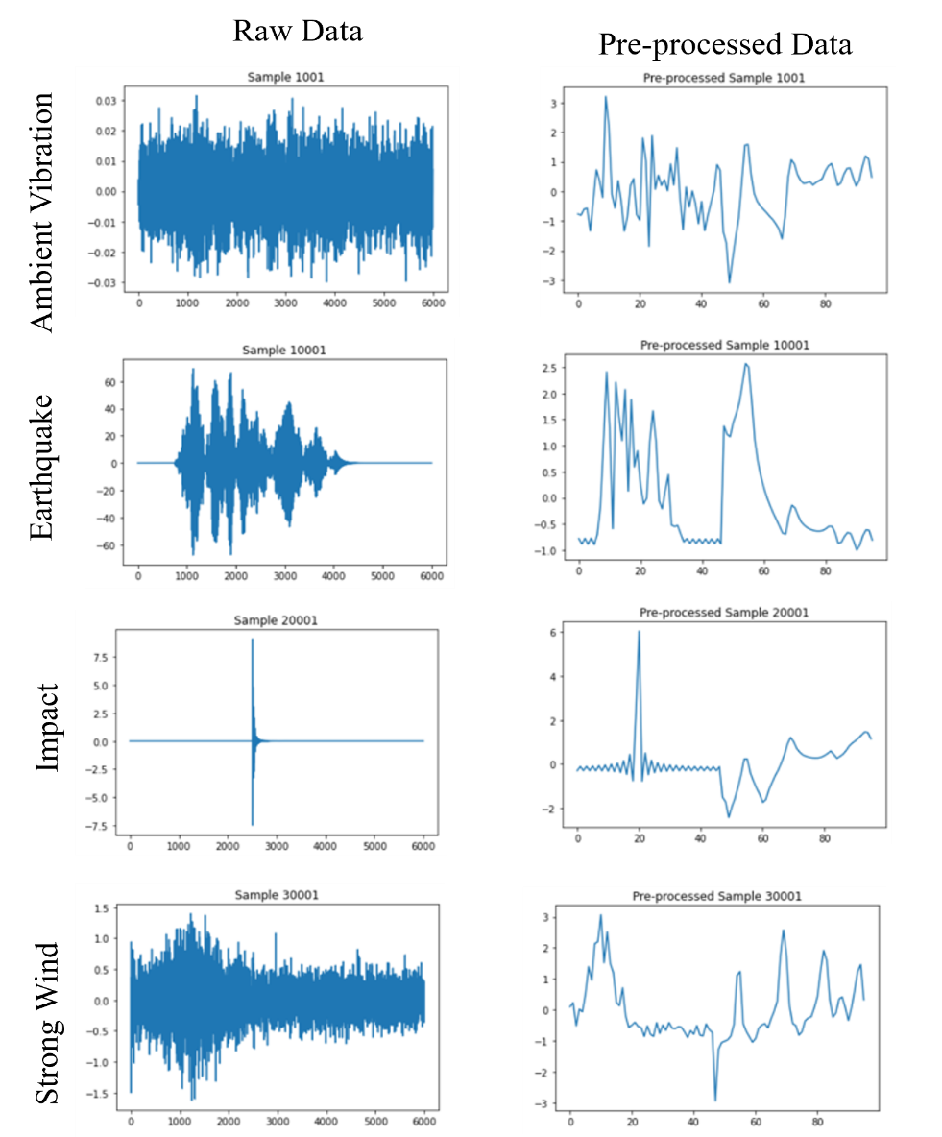


Distributed Edge Intelligence Enabling Framework for IoT-based Structural Health Monitoring
3-2 Event Classification & 1D CNN Network
Event Classification
Feature Engineering
Lightweight
Knowledge Embedding
Events
AV
IP
EQ
SW
Signal (6000 points)
Structures
Equation of Motion
Time Domain
Frequency Domain
Responses
Newmark-Beta
Down Sampling (128 points)
1D Convolutional Neural Network
Lightweight 1D CNN Classifier
44
8
Model Selection
4x3+4
4x2
4x4+4
Long-Short-Term Memory Network (1D / Time-Consuming)
Convolutional Neural Network (CV-2D / TS-1D )
4x2
Signal + Filters
1x128x1 | 1x3x4
Conv + BN + ReLu
1x128x4
Avg Pooling
1x1x4
FC
1x1x4
Label
1x1x1
SHUAIWEN CUI
NANYANG TECHNOLOGICAL UNIVERISITY | SINGAPORE
03 Federated Learning for Event Classification – Event Classification & 1D CNN Network
SHUAIWEN CUI
Notes:
Federated Learning is a training paradigm, not an algorithm.
For event classification, still, we focus on four types of events and their structural responses.
For NN model, after selection, 1D CNN model is selected to be used as a baseline.
One critical step for light-weight is feature engineering, which can make the model lightweight by embedding domain knowledge. Using time- and frequency-domain features and down-sampling, we reduce a signal from 6000 samples to as few as 128 samples.
After that, a lightweight 1D CNN with only 44 trainable parameters is used for classification, ensuring both efficiency and accuracy.

Slide 33
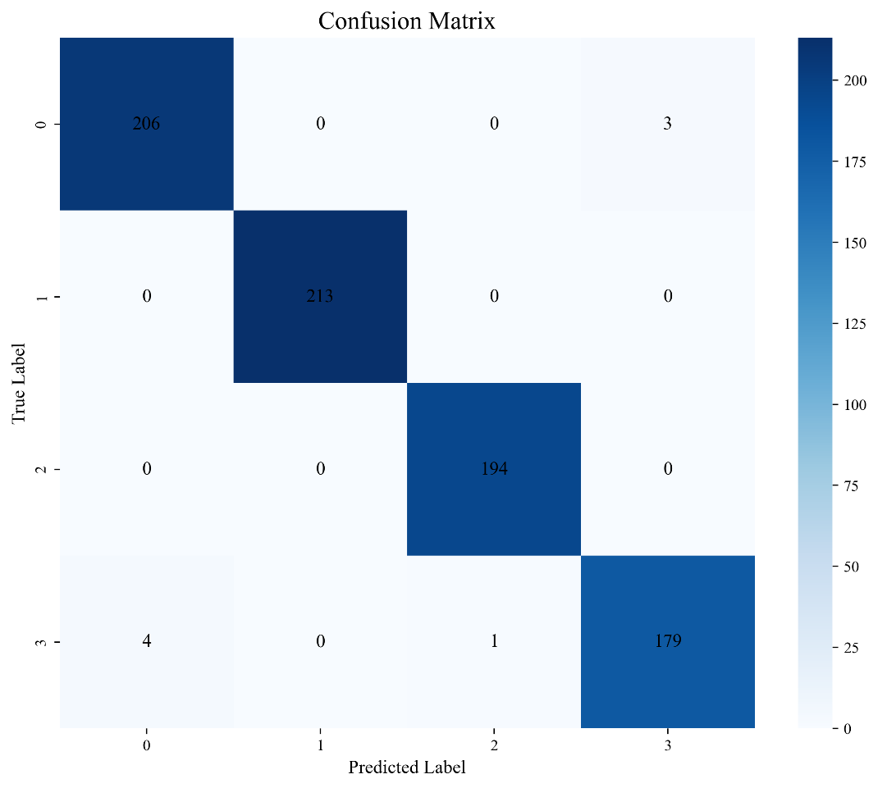
Distributed Edge Intelligence Enabling Framework for IoT-based Structural Health Monitoring
3-2 Event Classification & 1D CNN Network
Training Curve
Confusion Matrix
206
213
194
179
Performance on Test Set (800 Samples )
Training Set Size (2400 Samples) | Validation (800 Samples)
Test Acc > 99%
SHUAIWEN CUI
NANYANG TECHNOLOGICAL UNIVERISITY | SINGAPORE
03 Federated Learning for Event Classification – Event Classification & 1D CNN Network
SHUAIWEN CUI
Notes:
Though lightweight, the CNN model has a good performance for classification.
Used as a baseline model for FL.

Slide 34




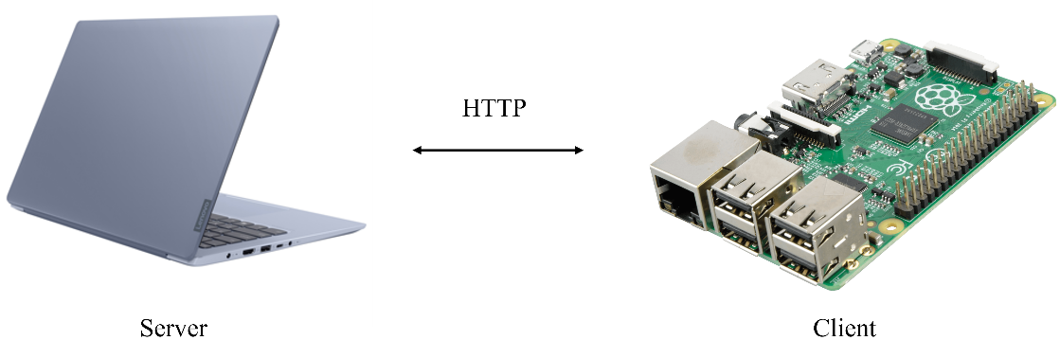

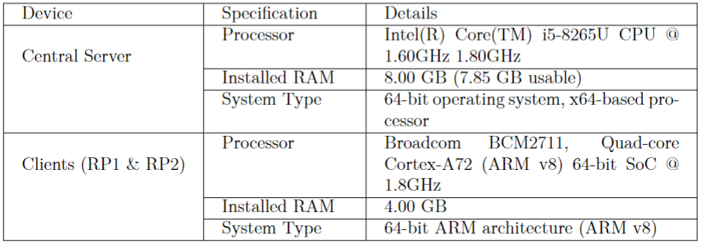

Distributed Edge Intelligence Enabling Framework for IoT-based Structural Health Monitoring
3-3 Federated Learning for Event Classification
Credits
Setup
Thang Khan Khual
Chen Yong Han, John
Devices for Implementation
Laptop
Local
Training
Parameter Averaging
Local
Training
RPI 1
RPI 2
Training: 30720
Testing: 7680
Total: 38400
Training: 3072
Testing: 768
Total: 3840
SHUAIWEN CUI
NANYANG TECHNOLOGICAL UNIVERISITY | SINGAPORE
03 Federated Learning for Event Classification – Federated Learning for Event Classification
SHUAIWEN CUI
Notes:
The FL part was finished in collaboration with two FYP students, Khual and John, and I want to thank them for their contributions.
In this study, a laptop was used to simulate the server, while two Raspberry Pi devices acted as the clients.
The specifications of these devices are shown in the table.
The simulation setup is displayed on the right-hand side. Note that size of dataset is different to simulate a common case in reality.

Slide 35
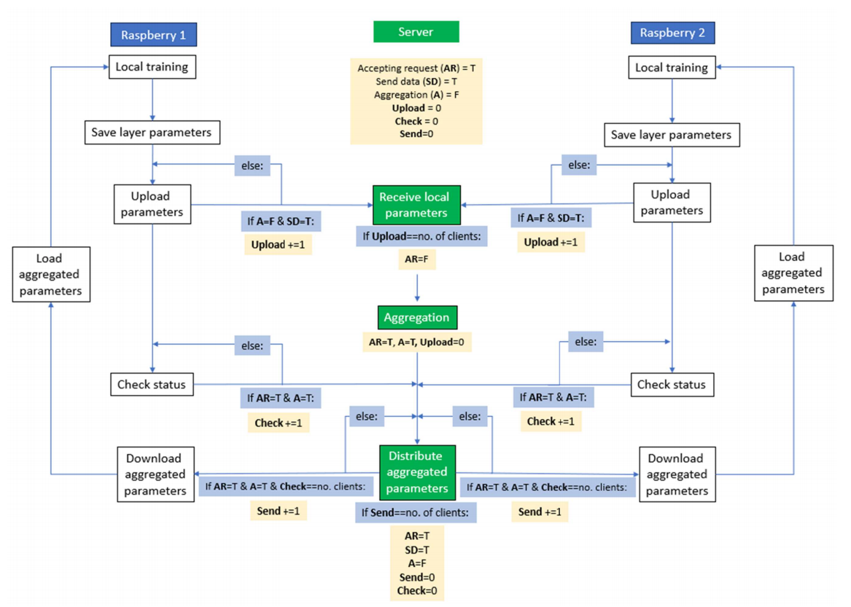

Distributed Edge Intelligence Enabling Framework for IoT-based Structural Health Monitoring
3-4 FL Simulation
Simulation Framework
FL Flowchart
Python-based Web Framework
Communication
Hypertext Transfer Protocol (HTTP)
SHUAIWEN CUI
NANYANG TECHNOLOGICAL UNIVERISITY | SINGAPORE
03 Federated Learning for Event Classification – FL Simulation
SHUAIWEN CUI
Notes:
The programming part is based on Flask, a python-based web framework, and the communication is completed by HTTP protocol.
On the right-hand side is the flow chart for FL simulation, showing many technical considerations.

Slide 36
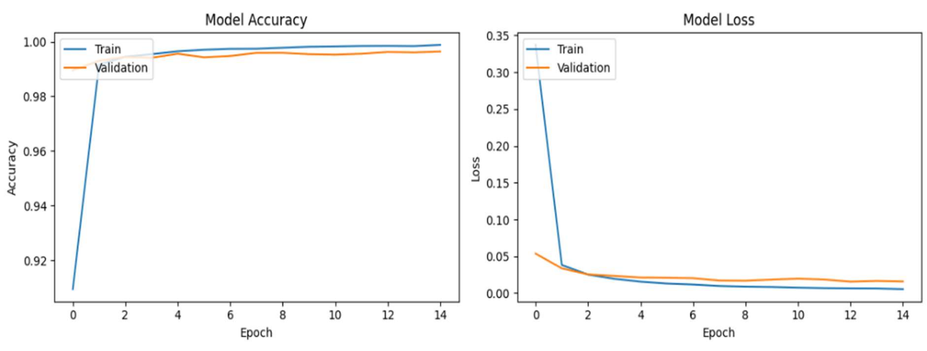
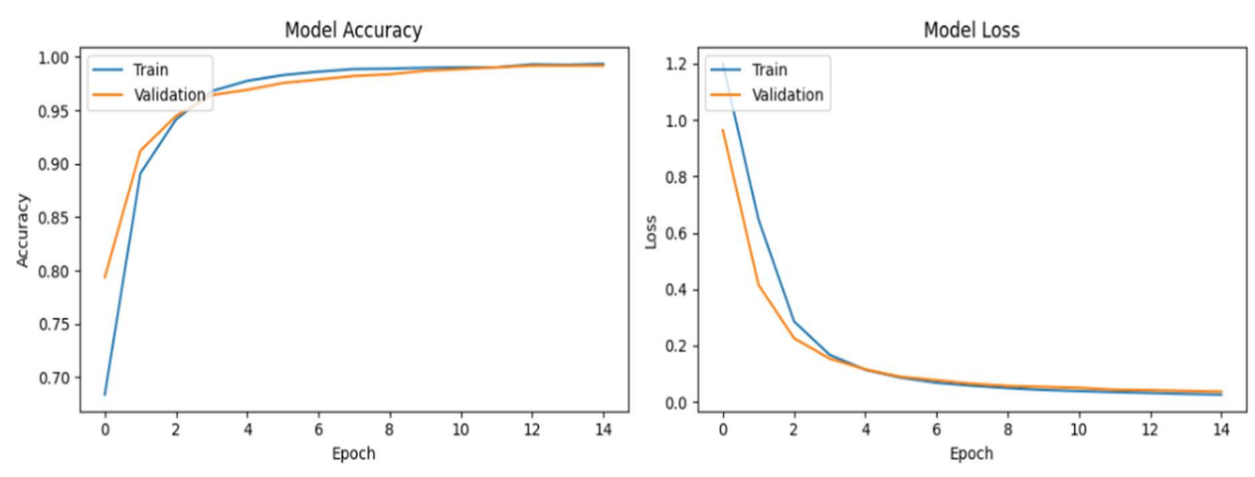
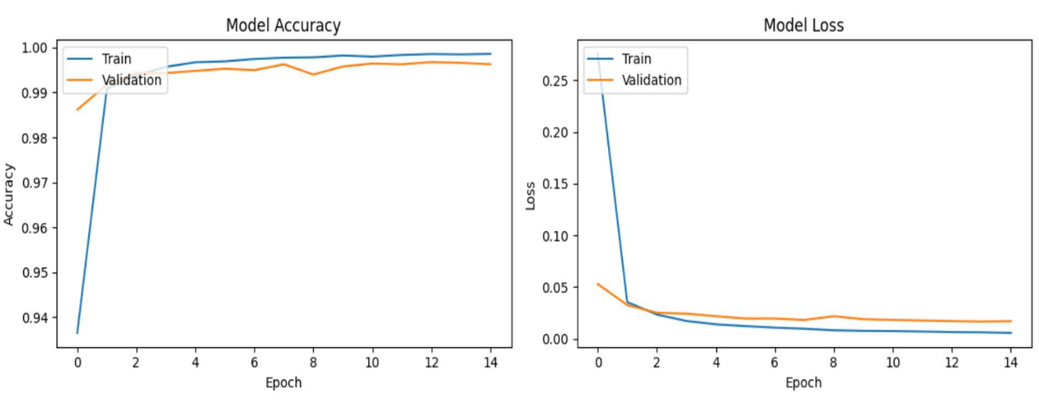

Distributed Edge Intelligence Enabling Framework for IoT-based Structural Health Monitoring
3-5 Results & Discussion
Baseline Model vs Federated Learning Model Performance - Comparable
Model Training – Client 1 – Without FL
Model Training – Client 2 – Without FL
Test Acc 99.64%
Test Acc 99.19%
Model Training – Client 1 – With FL (5 rounds)
Model Training – Client 2 – With FL (5 rounds)
Test Acc 99.63%
Test Acc 99.19%
SHUAIWEN CUI
NANYANG TECHNOLOGICAL UNIVERISITY | SINGAPORE
03 Federated Learning for Event Classification – Results and Discussion
SHUAIWEN CUI
Notes:
And here are the results.
These pictures are about the training process when training the baseline model without FL.
These pictures are about the training process when training the model with FL.
As can be seen, the model performance are quite similar, showing that FL will not introduce difference into model performance.

Slide 37

Distributed Edge Intelligence Enabling Framework for IoT-based Structural Health Monitoring
3-5 Results & Discussion
Transmission Over Head – Significantly Reduced !
Model Training Transmission – Without FL
To Do
Number of Records x Points Per Record x Bytes Per Point
(38400 + 3840) x 6000 x 4 = 966.80 MB ~ 1 GB
MPU > MCU
Onboard Training
Multi-node Coordination
Model Training Transmission – FL (5 rounds)
Trainable Parameter 44 (176B) | Optimizer Parameter 90 (360B)
Communication Overhead: 4.14 KB
Round 1 Distribution
536B x 2 = 1072B
Round 1 Uploading + Round 2-5 Distribution & Uploading
176B x 2 x 9 = 3168B
4.14KB / 1GB = 0.00042%
SHUAIWEN CUI
NANYANG TECHNOLOGICAL UNIVERISITY | SINGAPORE
03 Federated Learning for Event Classification – Results and Discussion
SHUAIWEN CUI
Notes:
Now, let’s estimate the communication payload for these two training paradigms.
Without FL, all raw data must be sent to a remote server, resulting in a payload of about 1GB—this means high power consumption and latency.
With FL, assuming 5 training rounds, the payload is only about 4 KB, which is significantly smaller. This highlights the potential of FL for IoT systems.
Looking ahead, there’s still much to be done. Currently, the mechanism runs on MPU devices, but we aim to move to MCU devices, which presents new challenges:
Onboard training: MCU devices lack proper tools for training.
Multi-node coordination: Efficient tools are needed for communication.
Once completed, we’ll conduct a more detailed evaluation, focusing on communication overhead, power consumption, and latency.

Slide 38
Distributed Edge Intelligence Enabling Framework for IoT-based Structural Health Monitoring
01
02
Prototype Development
Smart Adaptive Triggering
03
04
Federated Learning for Event Classification
Conclusions & Plans
SHUAIWEN CUI
NANYANG TECHNOLOGICAL UNIVERISITY | SINGAPORE
04 Conclusions & Plans
SHUAIWEN CUI

Slide 39

Distributed Edge Intelligence Enabling Framework for IoT-based Structural Health Monitoring
4-1 Conclusions
Prototype Development
Algorithm Development
Framework - TinySHM
Smart Adaptive Triggering Mechanism
Edge Intelligence Powered SHM Applications
Low-cost Low-Power Devices
Long-Term Large-Scale Autonomous
Feedback Control, Digital Twin, NN, Bayesian Optimization
Adaptive Fast-convergence Parameter Optimization
Sensor Node - LiftNode
Federated Learning for Event Classification
Low-Price Low-Power Sensing Node
Layered & Modularized
Validated In Projects
Federated Learning Framework for Event Classification
Great Potential to Reduce Communication Overhead and Power Consumption
SHUAIWEN CUI
NANYANG TECHNOLOGICAL UNIVERISITY | SINGAPORE
04 Conclusions & Plans – Conclusions
SHUAIWEN CUI
Notes:
Prototyping: This research focuses on developing a framework for edge intelligence-powered SHM applications on low-cost, low-power devices, enabling long-term, large-scale autonomous sensing.
To support and validate this framework, a low-cost, low-power sensor node has been prototyped with a layered and modularized software architecture. Its effectiveness has been demonstrated in multiple projects.
Algorithm Development: This research introduces a smart adaptive triggering mechanism that integrates feedback control, digital twin models, neural networks, and Bayesian Optimization to achieve fast-convergence parameter optimization for event triggering.
Additionally, a federated learning workflow for SHM event classification is proposed, showing significant potential to reduce communication overhead and power consumption.

Slide 40


Distributed Edge Intelligence Enabling Framework for IoT-based Structural Health Monitoring
4-2 Publications & Future Plans
Publications
Plans
[1] Cui, S., Hoang, T., Mechitov, K., Fu, Y., & Spencer, B. (2024). Adaptive Edge Intelligence for Rapid Structural Condition Assessment using a Wireless Smart Sensor Network. Engineering Structures. (Accepted)
[2] Cui, S., Fu, H., Shen, W., Yu, X., Zhang, Q., & Fu, Y. (2024). Computing in IoT-based Structural Health Monitoring: A Review. TBD. (Finalizing)
[3] Cui, S., Fu, H., & Fu, Y. (2024). Revolutionizing Trigger Sensing with Edge Intelligence: Staged and Adaptive Solution for Accuracy and Energy-efficiency. TBD. (Under Preparation)
Prototyping – LiftNode & TinySHM
To Be Refined and Expanded for More Functions
Federated Learning for Event Classification
MCU Deployment: Onboard Training & Coordination
More Distributed Edge Intelligence Approaches
Multi-Agent System
SHUAIWEN CUI
NANYANG TECHNOLOGICAL UNIVERISITY | SINGAPORE
04 Conclusions & Plans – Publications & Future Plans
SHUAIWEN CUI
Notes:
Till now, I have one paper got accepted, and two under preparation.
As for future studies:
First, the prototyping part will be continued.
Second, the FL learning part will move onto MCU devices, focusing on onboard training and multimode coordination.
Thirdly, I will explore more edge intelligence approaches, for example, multi-agent system.
And here is the timeline for my PhD study.

Slide 41


THANKS FOR LISTENING!
SHUAIWEN CUI
SHUAIWEN001@e.ntu.edu.sg
School of Civil and Environmental Engineering
Nanyang Technological University
MCU NODE (STM32)
MCU NODE (ESP32)

Slide 42

Distributed Edge Intelligence Enabling Framework for IoT-based Structural Health Monitoring
Appendix – IoT Architecture
SHUAIWEN CUI
NANYANG TECHNOLOGICAL UNIVERISITY | SINGAPORE
SHUAIWEN CUI

Slide 43

Distributed Edge Intelligence Enabling Framework for IoT-based Structural Health Monitoring
Appendix – IoT Architecture
SHUAIWEN CUI
NANYANG TECHNOLOGICAL UNIVERISITY | SINGAPORE
SHUAIWEN CUI

Slide 44

Distributed Edge Intelligence Enabling Framework for IoT-based Structural Health Monitoring
Appendix – Confusion Matrix
SHUAIWEN CUI
NANYANG TECHNOLOGICAL UNIVERISITY | SINGAPORE
SHUAIWEN CUI

Slide 45

Distributed Edge Intelligence Enabling Framework for IoT-based Structural Health Monitoring
Appendix – STM32
SHUAIWEN CUI
NANYANG TECHNOLOGICAL UNIVERISITY | SINGAPORE
SHUAIWEN CUI

Slide 46

Distributed Edge Intelligence Enabling Framework for IoT-based Structural Health Monitoring
Appendix – STM32
SHUAIWEN CUI
NANYANG TECHNOLOGICAL UNIVERISITY | SINGAPORE
SHUAIWEN CUI

Slide 47

Distributed Edge Intelligence Enabling Framework for IoT-based Structural Health Monitoring
Appendix – STM32
SHUAIWEN CUI
NANYANG TECHNOLOGICAL UNIVERISITY | SINGAPORE
SHUAIWEN CUI

Slide 48

Distributed Edge Intelligence Enabling Framework for IoT-based Structural Health Monitoring
Appendix – STM32
SHUAIWEN CUI
NANYANG TECHNOLOGICAL UNIVERISITY | SINGAPORE
SHUAIWEN CUI

Slide 49

Distributed Edge Intelligence Enabling Framework for IoT-based Structural Health Monitoring
Appendix – Digital Twin
SHUAIWEN CUI
NANYANG TECHNOLOGICAL UNIVERISITY | SINGAPORE
SHUAIWEN CUI

Slide 50

Distributed Edge Intelligence Enabling Framework for IoT-based Structural Health Monitoring
Appendix – Feedback Control
SHUAIWEN CUI
NANYANG TECHNOLOGICAL UNIVERISITY | SINGAPORE
SHUAIWEN CUI

Slide 51

Distributed Edge Intelligence Enabling Framework for IoT-based Structural Health Monitoring
Appendix – Deployment
SHUAIWEN CUI
NANYANG TECHNOLOGICAL UNIVERISITY | SINGAPORE
SHUAIWEN CUI

Slide 52

Distributed Edge Intelligence Enabling Framework for IoT-based Structural Health Monitoring
Appendix – Testbed
SHUAIWEN CUI
NANYANG TECHNOLOGICAL UNIVERISITY | SINGAPORE
SHUAIWEN CUI

Slide 53

Distributed Edge Intelligence Enabling Framework for IoT-based Structural Health Monitoring
Appendix – Environment
SHUAIWEN CUI
NANYANG TECHNOLOGICAL UNIVERISITY | SINGAPORE
SHUAIWEN CUI

Slide 54

Distributed Edge Intelligence Enabling Framework for IoT-based Structural Health Monitoring
Appendix – Bayesian Optimization
SHUAIWEN CUI
NANYANG TECHNOLOGICAL UNIVERISITY | SINGAPORE
SHUAIWEN CUI

Slide 55















Distributed Edge Intelligence Enabling Framework for IoT-based Structural Health Monitoring
Appendix – Bayesian Optimization
Controller
$𝓧$ – variable domain (threshold, duration)
$f$ – the real objective function
Black Box Problem
$$F_{β}$$
Expensive Evaluation
$𝓓$ – observation dataset, {$(x_{1},y_{1})$, $\left(x_{2},y_{2}\right)$, …, $(x_{n},y_{n})$}
$𝓢$ – acquisition function, to determine the next point to observe, need to trade-off between exploitation and exploration
threshold
duration
Bayesian Optimization
Bayesian Optimization Algorithm Framework
$𝓜$– the surrogate model, typically modelled as Gaussian Process $𝒢𝒫$
Require：$f, 𝓧, 𝓢, 𝓜$
function / variable domain / acquisition function / surrogate model
$$𝓜\sim 𝒢𝒫(m\left(x\right), cov\left(x,x^{′}\right)+{σ_{n}}^{2}δ_{xx^{′}})$$
$𝓓←$InitSample($f,𝓧$)
initialize the observation set
$$m\left(x\right)= 𝔼(f(x))$$
for $i←\left|\left.𝓓\right|\right.$ to T do
$$cov\left(x,x^{′}\right)=𝔼((f\left(x\right)−m\left(x\right))(f\left(x^{′}\right)−m\left(x^{′}\right)))$$
p($y|x, 𝓓$) $←$FitModel($𝓜,𝓓$)
surrogate model regression
New Point Observation ($x^{∗}$, $y^{∗}$)
$x_{i}←$ ${\text{argmax}}_{x∈𝓧}𝓢(x,\text{p}\text{(}y|x, 𝓓\text{)})$
determine next point to investigate
$$y^{∗}|y \sim 𝒢𝒫(μ\left(x^{∗}\right),σ^{2}(x^{∗}))$$
$$y_{i}←f(x_{i})$$
get corresponding value
$𝓓←𝓓 ∪(x_{i},y_{i})$
update the observation set
$$μ\left(x^{∗}\right)=K\left(x^{∗}, X\right){(K\left(X,X\right)+σ_{n}^{2}I)}^{−1}y$$
end for
$$σ^{2}\left(x^{∗}\right)=K\left(x^{∗},x^{∗}\right) −K\left(x^{∗}, X\right){\left(K\left(X,X\right)+σ_{n}^{2}I\right)}^{−1}K(X,x^{∗})$$
SHUAIWEN CUI
NANYANG TECHNOLOGICAL UNIVERISITY | SINGAPORE
SHUAIWEN CUI

Slide 56

Distributed Edge Intelligence Enabling Framework for IoT-based Structural Health Monitoring
Appendix – GPR Kernel
SHUAIWEN CUI
NANYANG TECHNOLOGICAL UNIVERISITY | SINGAPORE
SHUAIWEN CUI

Slide 57


Distributed Edge Intelligence Enabling Framework for IoT-based Structural Health Monitoring
Appendix – Sampling Function
SHUAIWEN CUI
NANYANG TECHNOLOGICAL UNIVERISITY | SINGAPORE
SHUAIWEN CUI

Slide 58





Distributed Edge Intelligence Enabling Framework for IoT-based Structural Health Monitoring
Appendix – Smart Adaptive Triggering Mechanism Stage I
Data Synthesizing
AI Model Training
Simulated
Excitation
Simulated
Response
CNN
Classifier
Digital Structure
Feature Engineering
Feature
Time Domain
& Frequency Domain
Label
Synthesized
Response
Real
Excitation
Triggering Mechanism
Noise Level
DNN
Estimator
duration
Threshold
Real
Response
Duration
Physical Structure
threshold
Recall
Legend
Physical World
Virtual World
Key Results
SHUAIWEN CUI
NANYANG TECHNOLOGICAL UNIVERISITY | SINGAPORE
SHUAIWEN CUI

Slide 59




Distributed Edge Intelligence Enabling Framework for IoT-based Structural Health Monitoring
Appendix – Smart Adaptive Triggering Mechanism Stage II
Synthesized
Excitation
Digital Twin
Structure
Structure
Response
Triggering Mechanism
duration
Reference
threshold
ENVIRONMENT – EXCITATION & STRUCTURE & RESPONSE
SYSTEM – TRIGGERING MECHANISM
threshold
$$F_{β}$$
$$F_{β}$$
duration
threshold
duration
threshold
duration
ESTIMATOR – F-BETA CALCULATION
$$F_{β}$$
SURROGATE MODEL - GPR
BAYESIAN OPTIMIZATION
PRECISION
P
TP
TP, FP, FN
CONTROLLER – BAYESIAN OPTIMIZATION
$$F_{β}$$
TP + FP
$$\left(1+β^{2}\right)\frac{P∙R}{β^{2}∙P+R}$$
RECALL
Virtual Dataflow
TP
Legend
Virtual World
TP + FN
R
SHUAIWEN CUI
NANYANG TECHNOLOGICAL UNIVERISITY | SINGAPORE
SHUAIWEN CUI

Slide 60


Distributed Edge Intelligence Enabling Framework for IoT-based Structural Health Monitoring
Appendix – Smart Adaptive Triggering Mechanism Stage III
Synthesized Excitation
Digital
Structure
Synthesized
Response
Triggering Mechanism
duration
Events
Noise
Real Excitation
Real
Structure
Real
Response
threshold
SYSTEM – TRIGGERING MECHANISM
Events
Noise
Reference
ENVIRONMENT – EXCITATION & STRUCTURE & RESPONSE
CONTROLLER – BAYESIAN OPTIMIZATION
$$F_{β}$$
PREPROCESS
$$F_{β}$$
duration
threshold
P
TP
threshold
duration
threshold
duration
TP + FP
FEATURES
$$F_{β}$$
SURROGATE MODEL - GPR
BAYESIAN OPTIMIZATION
PRECISION
NOISE LEVEL
$$F_{β}$$
RECALL
$$\left(1+β^{2}\right)\frac{P∙R}{β^{2}∙P+R}$$
THRESHOLD
R
R
DURATION
ESTIMATOR – F-BETA CALCULATION
SHUAIWEN CUI
NANYANG TECHNOLOGICAL UNIVERISITY | SINGAPORE
SHUAIWEN CUI

Slide 61


Distributed Edge Intelligence Enabling Framework for IoT-based Structural Health Monitoring
Appendix – NN Training (DNN – precision & recall)
SHUAIWEN CUI
NANYANG TECHNOLOGICAL UNIVERISITY | SINGAPORE
SHUAIWEN CUI

Slide 62

Distributed Edge Intelligence Enabling Framework for IoT-based Structural Health Monitoring
Appendix – Optimization Parameters
SHUAIWEN CUI
NANYANG TECHNOLOGICAL UNIVERISITY | SINGAPORE
SHUAIWEN CUI

Slide 63



Distributed Edge Intelligence Enabling Framework for IoT-based Structural Health Monitoring
Appendix – FL Confusion Matrices
SHUAIWEN CUI
NANYANG TECHNOLOGICAL UNIVERISITY | SINGAPORE
SHUAIWEN CUI

Slide 64


Distributed Edge Intelligence Enabling Framework for IoT-based Structural Health Monitoring
Appendix – FL Histograms
SHUAIWEN CUI
NANYANG TECHNOLOGICAL UNIVERISITY | SINGAPORE
SHUAIWEN CUI

Slide 65

Distributed Edge Intelligence Enabling Framework for IoT-based Structural Health Monitoring
Appendix – Anomaly Detection
SHUAIWEN CUI
NANYANG TECHNOLOGICAL UNIVERISITY | SINGAPORE
SHUAIWEN CUI

Slide 66

Distributed Edge Intelligence Enabling Framework for IoT-based Structural Health Monitoring
Appendix – Anomaly Detection
SHUAIWEN CUI
NANYANG TECHNOLOGICAL UNIVERISITY | SINGAPORE
SHUAIWEN CUI

Slide 67

Distributed Edge Intelligence Enabling Framework for IoT-based Structural Health Monitoring
Appendix – Anomaly Detection
SHUAIWEN CUI
NANYANG TECHNOLOGICAL UNIVERISITY | SINGAPORE
SHUAIWEN CUI

Slide 68

Distributed Edge Intelligence Enabling Framework for IoT-based Structural Health Monitoring
Appendix – Displacement Estimation
SHUAIWEN CUI
NANYANG TECHNOLOGICAL UNIVERISITY | SINGAPORE
SHUAIWEN CUI

Slide 69

Distributed Edge Intelligence Enabling Framework for IoT-based Structural Health Monitoring
Appendix – Bridges
SHUAIWEN CUI
NANYANG TECHNOLOGICAL UNIVERISITY | SINGAPORE
SHUAIWEN CUI

Slide 70

Distributed Edge Intelligence Enabling Framework for IoT-based Structural Health Monitoring
Appendix – Examples
SHUAIWEN CUI
NANYANG TECHNOLOGICAL UNIVERISITY | SINGAPORE
SHUAIWEN CUI

Slide 71

Distributed Edge Intelligence Enabling Framework for IoT-based Structural Health Monitoring
Appendix – Examples
SHUAIWEN CUI
NANYANG TECHNOLOGICAL UNIVERISITY | SINGAPORE
SHUAIWEN CUI

Slide 72

Distributed Edge Intelligence Enabling Framework for IoT-based Structural Health Monitoring
Appendix – Examples
SHUAIWEN CUI
NANYANG TECHNOLOGICAL UNIVERISITY | SINGAPORE
SHUAIWEN CUI

Slide 73

Distributed Edge Intelligence Enabling Framework for IoT-based Structural Health Monitoring
Appendix – Sudden Damage Detection
SHUAIWEN CUI
NANYANG TECHNOLOGICAL UNIVERISITY | SINGAPORE
SHUAIWEN CUI

Slide 74

Distributed Edge Intelligence Enabling Framework for IoT-based Structural Health Monitoring
Appendix – Sudden Damage Detection
SHUAIWEN CUI
NANYANG TECHNOLOGICAL UNIVERISITY | SINGAPORE
SHUAIWEN CUI

Slide 75
Distributed Edge Intelligence Enabling Framework for IoT-based Structural Health Monitoring
Appendix – Sudden Damage Detection
SHUAIWEN CUI
NANYANG TECHNOLOGICAL UNIVERISITY | SINGAPORE
SHUAIWEN CUI

Slide 76

Distributed Edge Intelligence Enabling Framework for IoT-based Structural Health Monitoring
Appendix – Sudden Damage Detection
SHUAIWEN CUI
NANYANG TECHNOLOGICAL UNIVERISITY | SINGAPORE
SHUAIWEN CUI

Slide 77


Distributed Edge Intelligence Enabling Framework for IoT-based Structural Health Monitoring
Appendix – Sudden Damage Detection
SHUAIWEN CUI
NANYANG TECHNOLOGICAL UNIVERISITY | SINGAPORE
SHUAIWEN CUI

Slide 78

Distributed Edge Intelligence Enabling Framework for IoT-based Structural Health Monitoring
Appendix – Sudden Damage Detection
SHUAIWEN CUI
NANYANG TECHNOLOGICAL UNIVERISITY | SINGAPORE
SHUAIWEN CUI

